Slide 1
Coala January 2014 German resources for new exam specifications

Slide 2
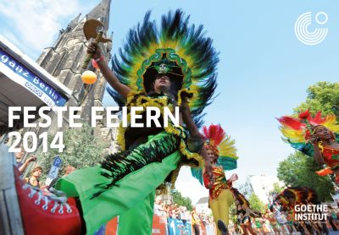
Calendar sheets – 2014 - Feste feiern 2013 - Jugend in Deutschland
* Images
* Reading texts
* Information
* Worksheets
* Teaching materials
http://www.goethe.de/ins/gb/gla/lhr/en12072687.htm

Slide 3
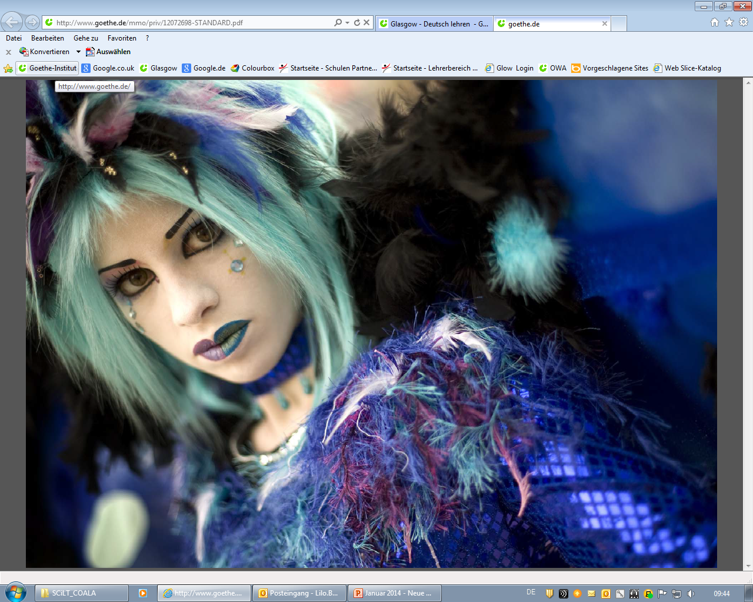

Slide 4
Internetpages ‚AUF DEUTSCH‘
http://aufdeutsch.co.uk/
BACKGROUND
perceived lack of authentic language materials for young learners
AimS
To provide resources appropriate to the target age-group
To motivate younger learners to engage with the material
To create a stimulating experience without usual limitations of preparing for an exam

Slide 5
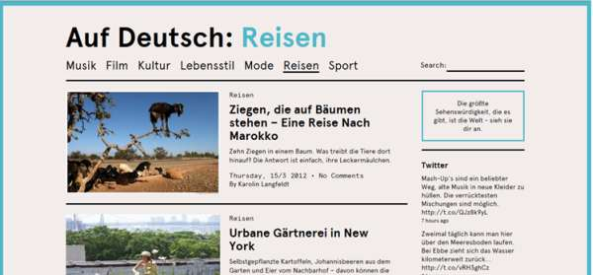
HOMEPage LAYOUT
TOPICS
7 main topics
each topic has its own colour code

Slide 6
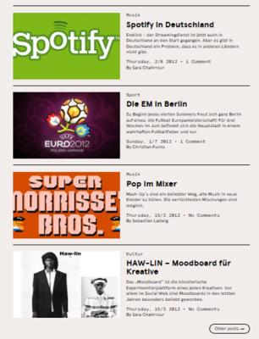
HOMEPage LAYOUT
Latest Articles
The five most recent articles are displayed on the homepage underneath the featured articles

Slide 7
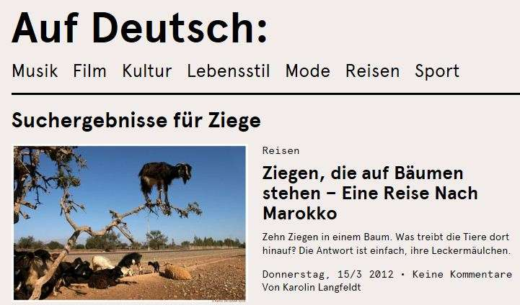
HOMEPage LAYOUT
Search function
accessible from every area of website (home / topic /article)
search for keywords in the articles (e.g. Ziege)
→

Slide 8
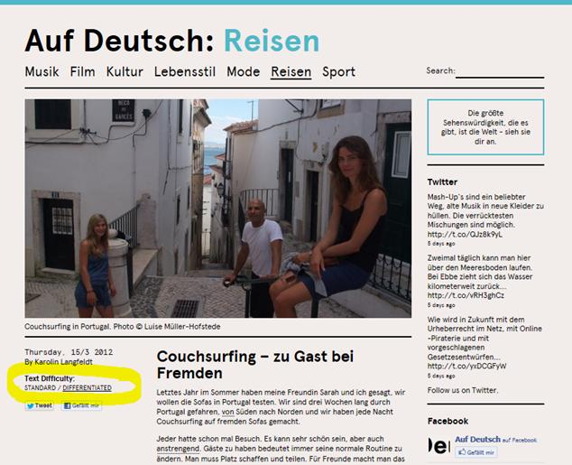
ARticles
accompanied by at least one picture and a quote
for every text there are two versions available: STANDARD and DIFFERENTIATED

Slide 9
ARticles
Descriptions
a description is available for the underlined words in each article
when hovering over the underlined word with your mouse, the description appears in the left-hand column

Slide 10
ARticles
Links
embedded in the articles and highlighted in bold
give further information, links to German websites, etc.
→

Slide 11
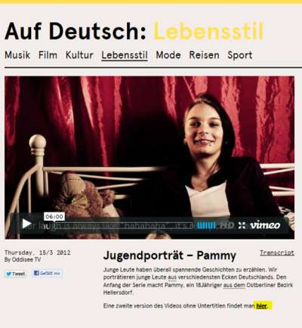
Video Content
videos with content of interest to young learners are available in German with English subtitles
a second version without subtitles is also available
by clicking on the Transcript button the video transcript appears in a separate window
text is highlighted in bold to correspond with the words as they are spoken in the film
to listen to a sentence again, just click on that section of the transcript
←
←

Slide 12
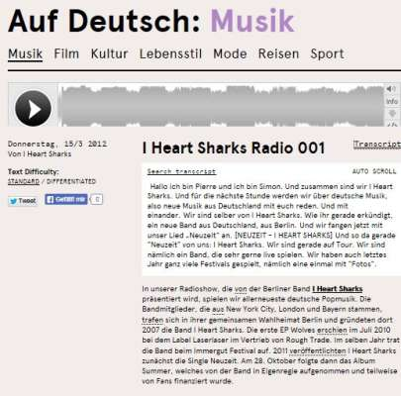
Audio Content
mix of speech and music
audio files transcript available with same functions as video transcripts (such as search, auto scroll, repeat function)
←

Slide 13
We would be happy to receive your feed-back: Language@Glasgow.goethe.org boergmann@ glasgow.goethe.org Vielen Dank!

